Slide 1

Python Concept
Sharing

Slide 2
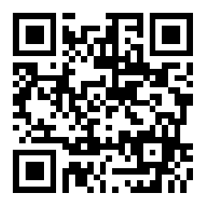
Slido for QNA
https://app.sli.do/event/oepYmqTkYK2eyP3NXMqnsD

Slide 3
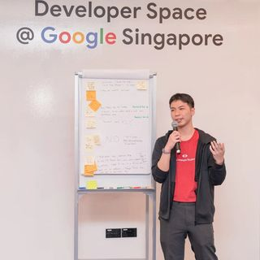


Lai Kai Yong (Vandyck)
Full Stack Software Engineer
GDSC Lead @APU
MLSA
@vandyck.lai
Kai Yong Lai (Vandyck)

